Slide 1


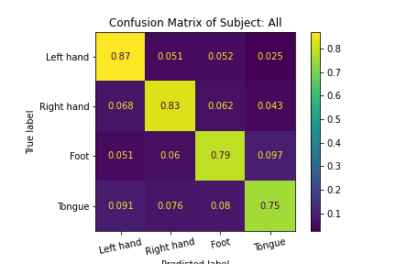
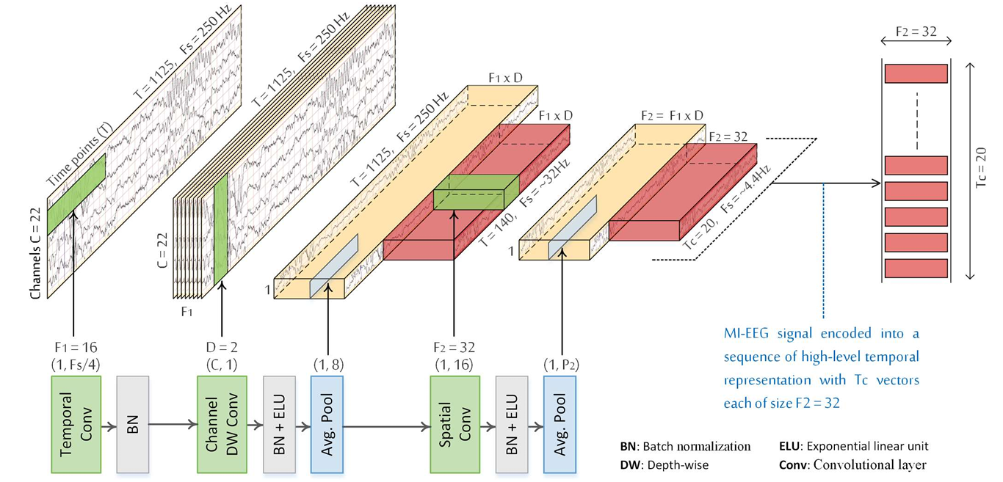
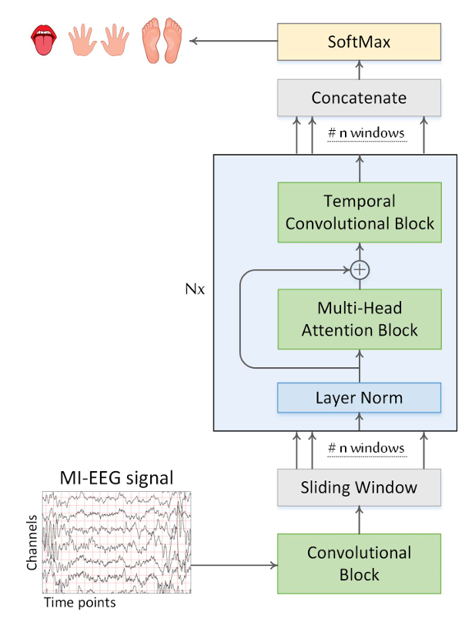
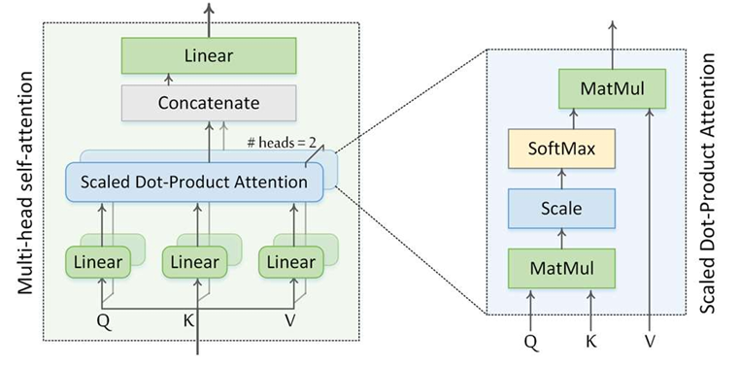
Skelly: A Mind Booster Game
By: Ezz khalil, Ahmed Awad, Mohammed Khalifa,
Mohammed Abd El-raouf, Abdelrahman Emam,
Caroline Atta
Supervised by: Dr.Manal Tantawy , TA. Aya Nasser
Faculty of Computer and Information Sciences - Ain Shams University
Abstract
Results
This project presents "Skelly," an innovative brain-controlled game designed to help individuals with disabilities engage in entertaining and rehabilitative activities. By using Brain-Computer Interface (BCI) technology, players can navigate through various maze levels using their brain signals (EEG), providing a unique gaming experience and therapeutic benefits. The BCI Competition IV dataset 2a, comprising motor imagery tasks from nine subjects, was utilized to train our deep learning model, ATCNet, which demonstrated a high average accuracy of 87.16% in decoding EEG signals into control commands. "Skelly" illustrates the potential of integrating BCI technology into gaming, offering an inclusive platform for users to interact with digital environments through their thoughts, enhancing both their gaming experience and rehabilitation process.
The implementation of "Skelly" was evaluated using the BCI Competition IV dataset 2a, which includes data from nine subjects performing motor imagery tasks. The dataset was crucial in training our deep learning model, ATCNet, which was designed to decode EEG signals into actionable control commands for navigating the game.
The model's performance was assessed based on its accuracy in interpreting the motor imagery tasks for each subject. The table below summarizes the classification accuracies achieved for the nine subjects. These results demonstrate the model's reliability and robustness in translating EEG signals into game controls, highlighting the potential for using BCI technology in real-world applications.
The average classification accuracy achieved by the ATCNet model was 87.16%, which indicates a high level of precision in decoding the brain's signals. This level of accuracy ensures that users can effectively control the game character using their thoughts, providing an engaging and accessible gaming experience.
Introduction
Table I: Subjects Accuracy.
The advent of Brain-Computer Interface (BCI) technology has opened new avenues for interaction between humans and digital environments, particularly benefiting individuals with physical disabilities or injuries. Traditional gaming interfaces, such as controllers and keyboards, are not always accessible to these users, limiting their engagement with interactive digital content. Additionally, current rehabilitation methods for injured individuals often lack the motivational and interactive elements necessary for sustained engagement and effective recovery.
This project introduces "Skelly," a brain-controlled game designed to navigate various maze levels using EEG signals. "Skelly" aims to provide an inclusive entertainment platform for individuals unable to use standard gaming controllers and serve as a novel rehabilitation tool. By enabling users to control the game character with their thoughts, "Skelly" offers a unique and stimulating way to interact with digital environments, enhancing both the quality of life and therapeutic outcomes for disabled and injured individuals.
The motivation behind this project is rooted in the global prevalence of disabilities. Approximately 1.3 billion people, or 16% of the world's population, live with disabilities, including brain diseases such as Amyotrophic Lateral Sclerosis (ALS). ALS, affecting both middle-aged and younger individuals, results in severe motor function impairment, underscoring the need for accessible and engaging rehabilitation tools.
Subject | Accuracy
Subject 1 | 84.48%
Subject 2 | 77.59%
Subject 3 | 89.66%
Subject 4 | 81.03%
Subject 5 | 87.93%
Subject 6 | 77.59%
Subject 7 | 96.55%
Subject 8 | 94.83%
Subject 9 | 94.83%
Average Acc. | 87.16%
Conclusions
Methodology
The "Skelly" project successfully demonstrates the integration of Brain-Computer Interface (BCI) technology into a gaming environment, providing a novel and inclusive method for individuals with physical disabilities or brain injuries to engage in digital activities. By utilizing the BCI Competition IV dataset 2a and training the ATCNet deep learning model, "Skelly" enables players to navigate maze levels using their brain signals, specifically motor imagery (MI) tasks. This approach not only offers an entertaining platform for those unable to use traditional controllers but also presents a potential tool for rehabilitation and therapeutic engagement.
we propose an attention-based temporal convolutional network, ATCNet, to decode MI-EEG brain signals. This research utilizes SciML to address domain-specific MI-EEG data challenges, which results in a robust, interpretable, and explainable DL model specifically designed for decoding MI-EEG brain signals.The proposed DL model processes the MI-EEG data in three steps: first, encode the MI EEG signal into a sequence of high-level temporal representations using conventional layers, then, highlight the most valuable information in the temporal sequence using an attention layer, and finally, extract high-level temporal features from the highlighted information using a temporal convolutional layer. The proposed model utilizes a multi-head self-attention and convolutional-based sliding window to boost the performance of MI classification..
The proposed ATCNet model consists of three main blocks: convolutional (CV) block, attention (AT) block, and temporal convolutional (TC) block.
Bibliography
Physics-informed attention temporal convolutional network for EEG-based motor imagery classification | IEEE Journals & Magazine | IEEE Xplore. Available at: https://ieeexplore.ieee.org/document/9852687/.
eegnet: A compact convolutional network for EEG-based brain-computer interfaces. Available at: https://www.researchgate.net/publication/310953136_EEGNet_A_Compact_Convolutional_Network_for_EEG-based_Brain-Computer_Interfaces.
X. Lun, Z. Yu, T. Chen, F. Wang, and Y. Hou, “A simplified CNN classification method for MI-EEG via the electrode pairs signals,” Front. Hum. Neurosci., vol. 14, 2020.
T. Liu and D. Yang, “A Densely Connected Multi-Branch 3D Convolutional Neural Network for Motor Imagery EEG Decoding,” Brain Sci., vol. 11, no. 2, p. 197, 2021.
Y. Li, H. Yang, J. Li, D. Chen, and M. Du, “EEG-based intention recognition with deep recurrent-convolution neural network: Performance and channel selection by Grad-CAM,” Neurocomputing, vol. 415, pp. 225–233, 2020.

